Slide 1


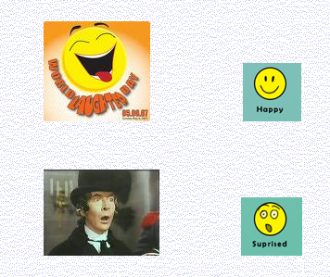
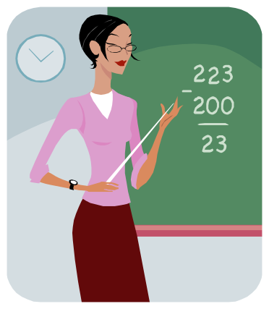
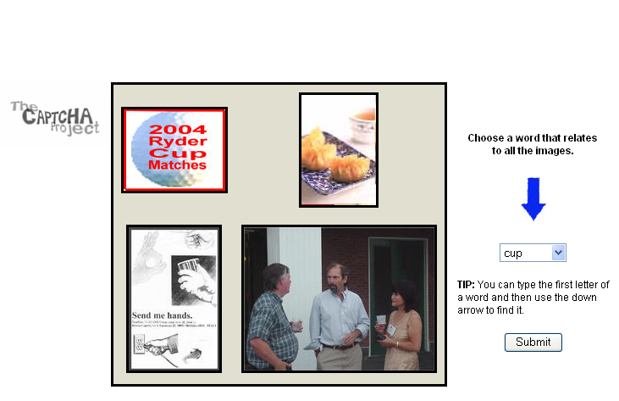
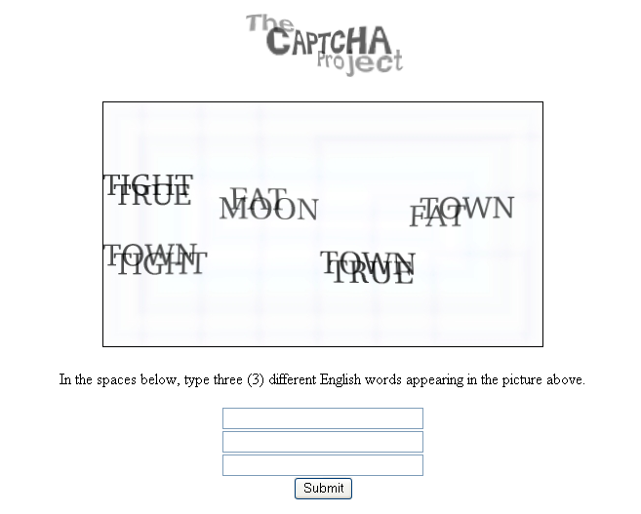
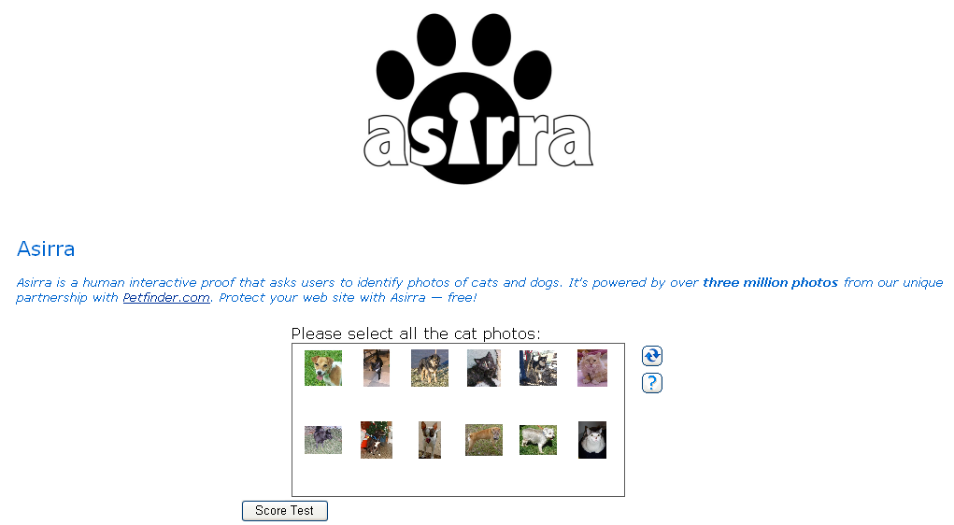


A Computer Based Personal Assistant Using HIPs
Suhas Aggarwal,IIT
suhas@iitg.ernet.in
Background
Goals
Design HIPs which can study humans and
contribute to their learning
SKILLS
Implement prototypes of these HIPs
Computer Based Assistant Model
Research Agenda
Studying People on various Grounds –
Daily routines – eating , sleeping habits – a possible benefit – health advise
Make them aware of their personality
Make them aware of their abilities and things they need to improve upon
Make them aware of the happenings around them
HIPs
Research Aim
Related Work/Interaction with Other Projects
To Develop A Computer Based Personal Assistant Using HIPs
CAPTCHA project – CMU
Asirra – Microsoft Research
Fundamental Questions/Challenges
Making sure these HIPs meet security
standards
Try to make these HIPs compliant with
HIPs with a purpose - motto
Notes:
on

